Slide 1
MUSIC GENRE CLASSIFICATION
OMKARAIAH P
PGDA25

Slide 2
AGENDA
Introduction to Music Genre Classification
Project Overview
System Prerequisites
Overview of Dataset
Libraries Installation
Implement music genre classification from scratch
Test New Audio Files
Conclusion

Slide 3
Introduction to Music Genre Classification:-
Audio processing is one of the most complex tasks in data science as compared to image processing and other classification techniques. One such application is music genre classification which aims to classify the audio files in certain categories of sound to which they belong. The application is very important and requires automation to reduce the manual error and time because if we have to classify the music manually then one has to listen out each file for the complete duration. So To automate the process we use Machine learning and deep learning algorithms

Slide 4
Dataset Overview:-
The dataset we will use is named the GTZAN genre collection dataset which is a very popular audio collection dataset. It contains approximately 1000 audio files that belong to 10 different classes. Each audio file is in .wav format (extension).
The classes to which audio files belong are
Blues
Hip-hop
classical
Pop
Disco
Country
Metal
Jazz
Reggae, and
Rock.

Slide 5
Libraries Installation:-
import os
import pandas as pd
import numpy as np
import seaborn as sns
import matplotlib.pyplot as plt
%matplotlib inline
import sklearn
import math
import librosa
import librosa.display
import warnings
warnings.filterwarnings('ignore’)
from python_speech_features import mfcc

Slide 6
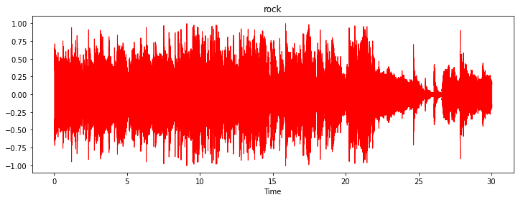
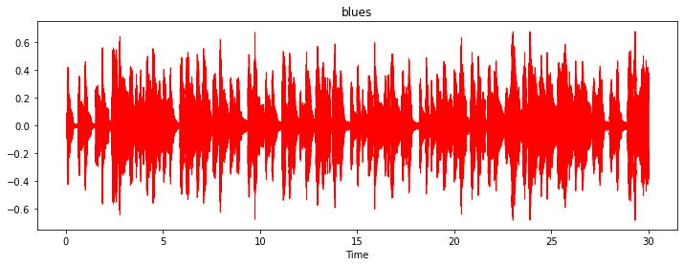
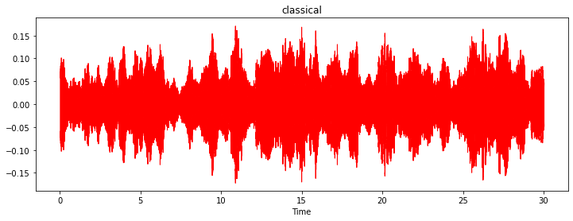
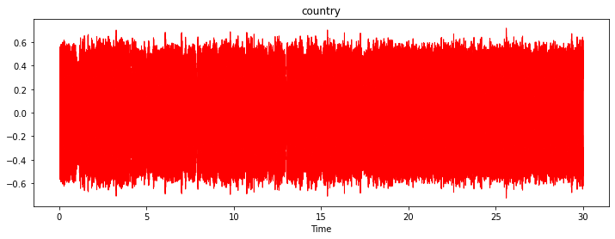
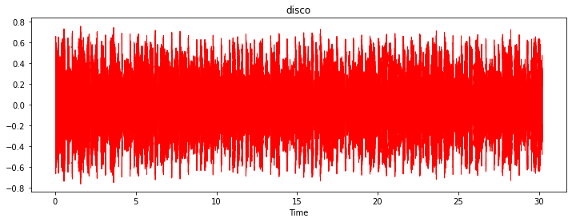
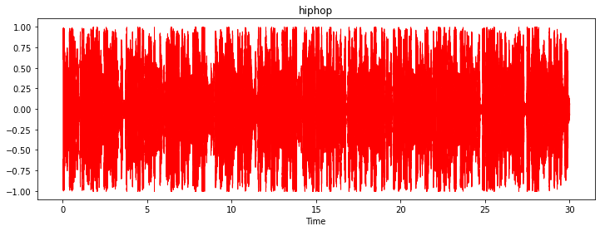
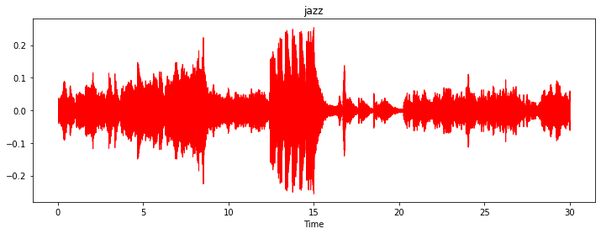
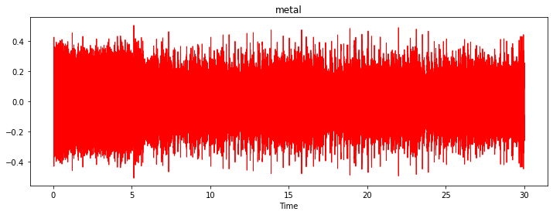
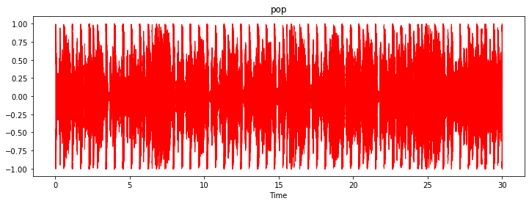
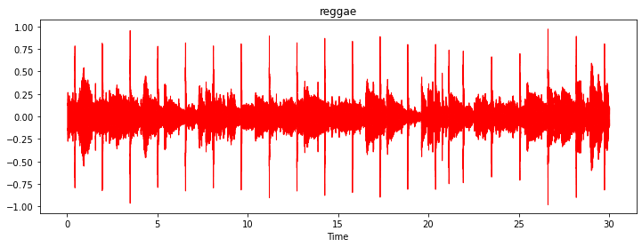
Wave plots of all genres:-
for i in genres:
aud,sr=librosa.load(os.path.join(path,'genres_original',i,f'{i}.00001.wav'))
plt.figure(figsize=(12,4))
librosa.display.waveshow(y=aud,sr=sr,color='r')
plt.title(f'{i}’)

Slide 7
#reading the 30 s csv data=pd.read_csv(os.path.join(path,'features_30_sec.csv')) data.head()
filename | length | chroma_stft_mean | chroma_stft_var | rms_mean | rms_var | spectral_centroid_mean | spectral_centroid_var | spectral_bandwidth_mean | spectral_bandwidth_var | ... | mfcc16_var | mfcc17_mean | mfcc17_var | mfcc18_mean | mfcc18_var | mfcc19_mean | mfcc19_var | mfcc20_mean | mfcc20_var | label
0 | blues.00000.wav | 661794 | 0.350088 | 0.088757 | 0.130228 | 0.002827 | 1784.165850 | 129774.064525 | 2002.449060 | 85882.761315 | ... | 52.420910 | -1.690215 | 36.524071 | -0.408979 | 41.597103 | -2.303523 | 55.062923 | 1.221291 | 46.936035 | blues
1 | blues.00001.wav | 661794 | 0.340914 | 0.094980 | 0.095948 | 0.002373 | 1530.176679 | 375850.073649 | 2039.036516 | 213843.755497 | ... | 55.356403 | -0.731125 | 60.314529 | 0.295073 | 48.120598 | -0.283518 | 51.106190 | 0.531217 | 45.786282 | blues
2 | blues.00002.wav | 661794 | 0.363637 | 0.085275 | 0.175570 | 0.002746 | 1552.811865 | 156467.643368 | 1747.702312 | 76254.192257 | ... | 40.598766 | -7.729093 | 47.639427 | -1.816407 | 52.382141 | -3.439720 | 46.639660 | -2.231258 | 30.573025 | blues
3 | blues.00003.wav | 661794 | 0.404785 | 0.093999 | 0.141093 | 0.006346 | 1070.106615 | 184355.942417 | 1596.412872 | 166441.494769 | ... | 44.427753 | -3.319597 | 50.206673 | 0.636965 | 37.319130 | -0.619121 | 37.259739 | -3.407448 | 31.949339 | blues
4 | blues.00004.wav | 661794 | 0.308526 | 0.087841 | 0.091529 | 0.002303 | 1835.004266 | 343399.939274 | 1748.172116 | 88445.209036 | ... | 86.099236 | -5.454034 | 75.269707 | -0.916874 | 53.613918 | -4.404827 | 62.910812 | -11.703234 | 55.195160 | blues

Slide 8
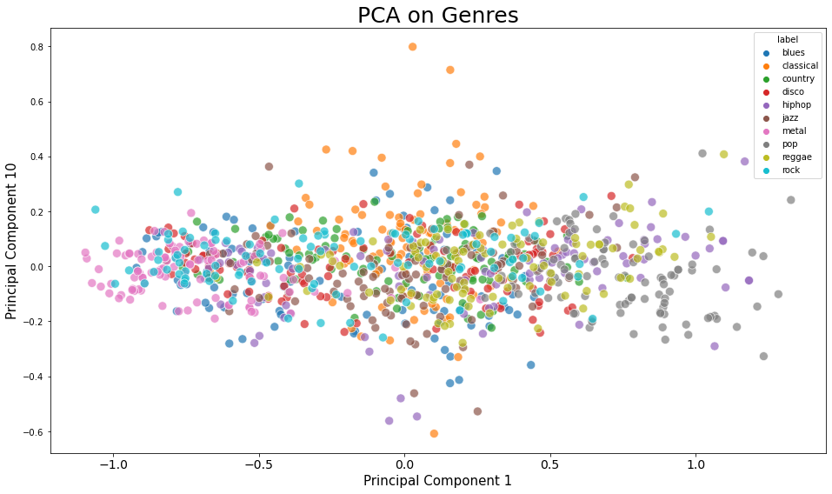
Principal component analysis (PCA) :-

Slide 9
Training the model
X_train,X_test,y_train,y_test=train_test_split(X,Y,test_size=0.3,random_state=21)
def model_assess(model,title):
model.fit(X_train,y_train)
preds=model.predict(X_test)
print('Accuracy', title, ':', round(accuracy_score(y_test, preds), 5), '\n’)
Naive Bayes
Stochastic Gradient Descent
KNN
Decission trees
Random Forest
Support Vector Machine
Logistic Regression
Neural Nets
Cross Gradient Booster (Random Forest)
improving xgb gradient booster

Slide 10
Training the Model and making predictions
MODEL | ACCURACY
Naive Bayes | 0.52386
Stochastic Gradient Descent | 0.64298
KNN | 0.8038
Decision trees | 0.64665
Random Forest | 0.79479
Logistic Regression | 0.67434
Neural Nets | 0.70103
Cross Gradient Booster | 0.89656
Support Vector Machine | 0.74274

Slide 11
Finding similar songs :-
def find_similar_songs(name):
# Find songs most similar to another song
series = sim_df_names[name].sort_values(ascending = False)
# Remove cosine similarity == 1 (songs will always have the best match with themselves)
series = series.drop(name)
# Display the 5 top matches
print("\n*******\nSimilar songs to ", name)
print(series.head(5))

Slide 12
Conclusion:-
The main thing to identify and divide the audio into different features is amplitude and frequency that changes within a short span of time.
We can visualize the audio frequency wave of amplitude and frequency with respect to time in form of a wave plot that can be easily plotted using librosa.
MFCCs total provides 39 features related to frequency and amplitude. In that 12 parameters are related to the amplitude of frequencies. It means it provides us with enough frequency channels to analyze audio and this is the reason MFCCs are used everywhere for feature extraction in audios.
The key working of MFCC is to remove vocal excitation (pitch information) by dividing audio into frames, make extracted features independent, adjust the loudness, and frequency of sound according to humans, and capture the context.

Slide 13
THANK YOU
POKURI OMKARAIAH
OMKARPOKURI06@GMAIL.COM

